Slide 1
Operating System
Varsha Dange

Slide 2
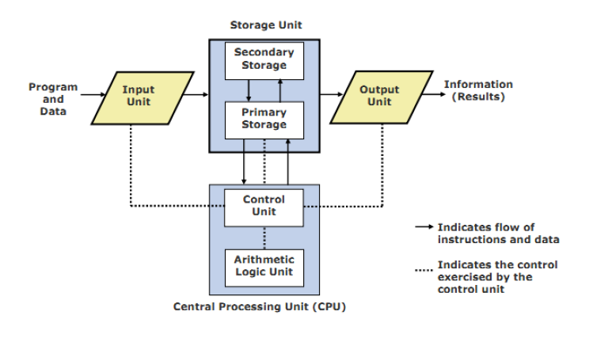
Block Diagram of a Computer(Logical)

Slide 3
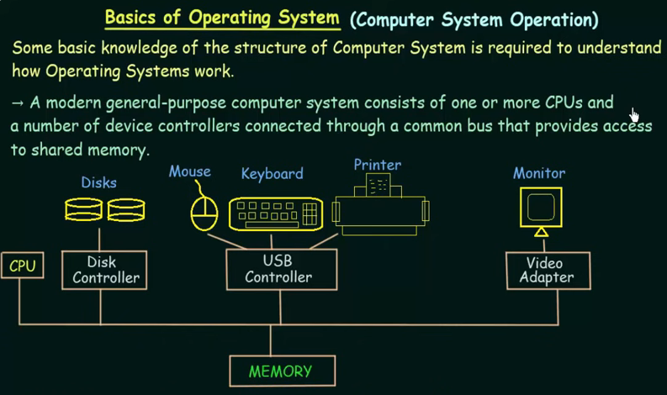

Slide 4
Introduction to Operating System
OS is a system software.
Software is a set of programs that perform certain operations /functions.
- application software
Used by end user e.g.-Payroll management system, student management system, Ms-Word, Ms-Excel
-System software
Software to create a program development environment. E.g.- Text Editor (notepad),Compiler, Assembler, Linker
Software to create runtime environment .E.g.- OS, Loader, dynamic linker

Slide 5
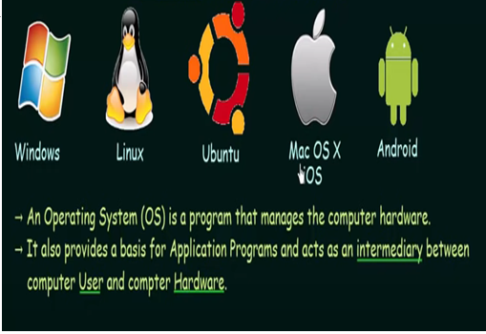

Slide 6
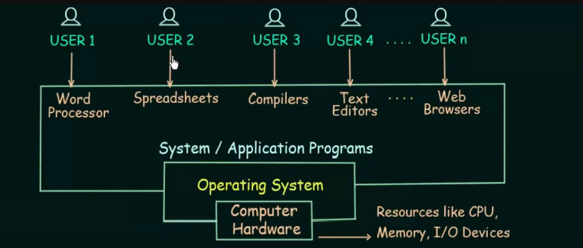
Basic structure/components of OS

Slide 7
OS is system software that manages computer hardware and software resources & provides common services for computer programs.
It is a software that manages & control all resources and effectively utilize every resources .Resources – CPU ,Main Memory, Files, Io devices
OS act viewed as a resource allocator because it act as a manager of h/w and s/w.

Slide 8
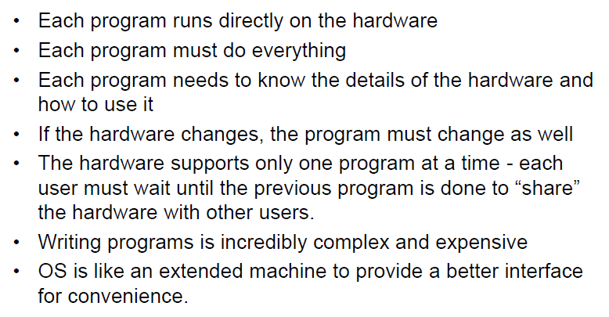
Without an OS

Slide 9
Goals of OS
Convenience (goal related with user)
OS mediator between user and hardware
OS hides details/peculiarity of hardware from users ,so users can use hardware conveniently
Efficiency (goal related with resources)
Os taken care that all resources should get used efficiently

Slide 10
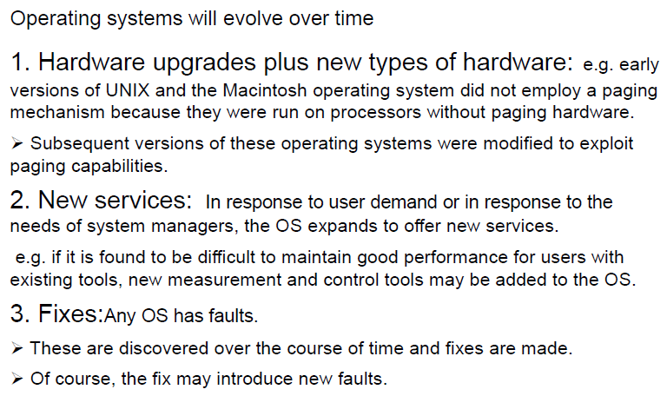
Evolution of Operating Systems

Slide 11
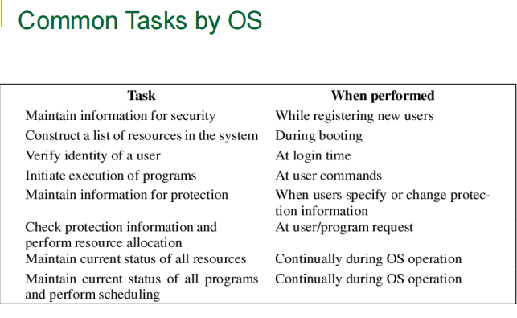

Slide 12
some important terms -
Bootstrap program- The initial program that runs when a computer is powered up or rebooted.
It is stored in the ROM.
It must now how to load OS and start executing that system
interrupt is a signal that prompts the OS to temporarily halt its current operations and execute a function or service routine to address the condition indicated by the interrupt.
Interrupts can be hardware or software-generated and are essential for efficient system operation, enabling the OS to respond promptly to various events.
A system call is a mechanism that allows a program to request a service from the operating system.
These services typically involve hardware-related tasks such as accessing the disk, creating a file, reading from a device, or communicating over a network.

Slide 13
Functions of OS
Process Management
Memory Management
Functions of OS
IO device Management
File Management
Security Management

Slide 14
1. Process Management
In process management ,OS do the management of CPU.
OS takes care of the allotment of CPU to different process.
When CPU is free ,OS select process from job sequence and allocate CPU to the process.
After process execution completed ,OS frees the processor and again select another process for execution
Selection of process from job sequence is done by scheduler using different scheduling algorithms such as FCFS ,SJF (shortest Job First),Priority or Round Robin.
In process management ,OS taken care of deadlock ,that should not be happened

Slide 15
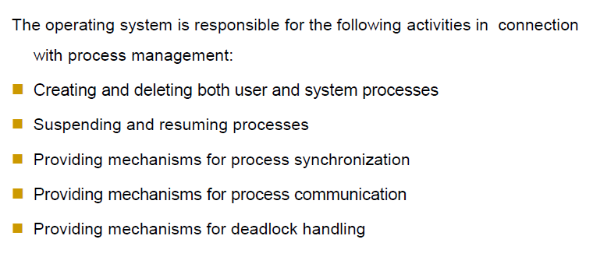
Process Management Activities

Slide 16
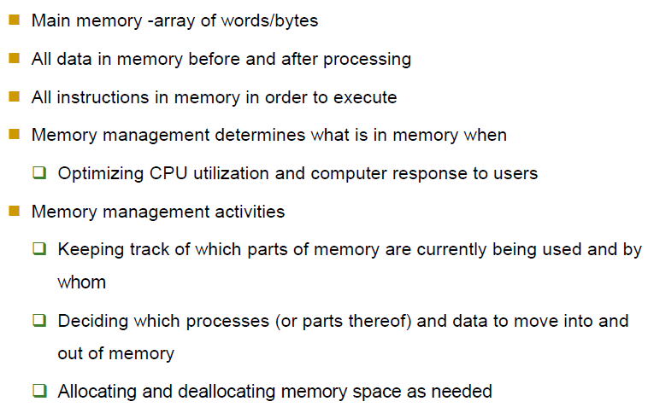
2. Main Memory Management

Slide 17
3. IO device Management
OS manages IO devices and makes it use efficient.
Accept input from Input device ,store it I memory ,ask CPU to process it and finally provides the result .
Controls all IO devices using a software called device drivers .
Keeps the track of all devices with the help of IO controller
Decide which process will get resource when and for how much time.
Allocate and deallocate the resources in efficient way

Slide 18
4. File Management
File is a logical collection of information.
File is stored on secondary memory ,disk etc.
File may contains text ,doc ,executable prg, or set of instructions to OS .
OS manages the files ,folder or directories .
OS keeps the track of files using FAT (File allocation table /NTFS)
OS takes care that files open with proper access rights(read/write or both)
Backup the files on stable storage media.

Slide 19
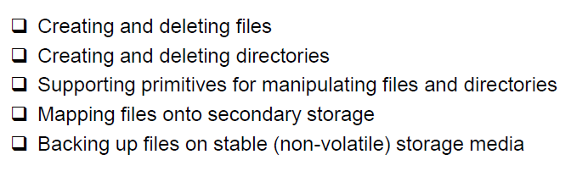
File Management Activities

Slide 20
5. Security Management
Viruses, Threats can disturb the normal operation of computer
Sometimes it can be very harmful
Os has built-in tools to protect against the threats
Uses virus scanning utility
Prevent unauthorized access by Authentication at login time

Slide 21
Operating System Services
User Interface
Program execution
File system Manipulation
IO operations
Communication
Resource allocation
Error detection
Accounting
Security & protection

Slide 22
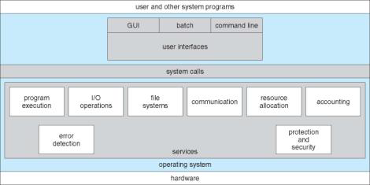
A View of OS services

Slide 23
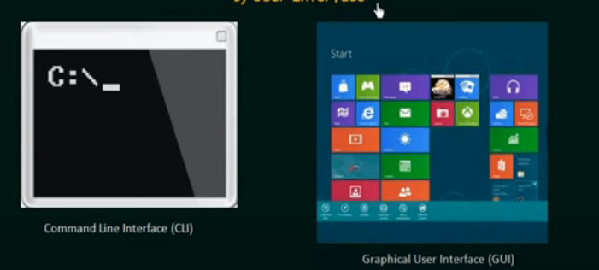
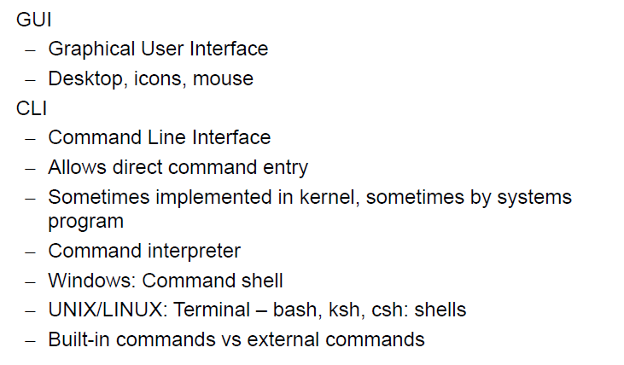
1. User Interface
Batch interface-
- writing multiple commands in a file and then execute the file

Slide 24
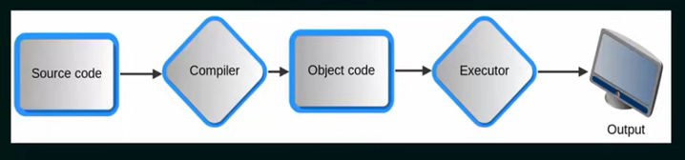
2.Program execution
Program execution- program is loaded into the main memory before execution
The system must be able to load a program into memory and to run that program & end execution , either normally or abnormally (indicating error)

Slide 25
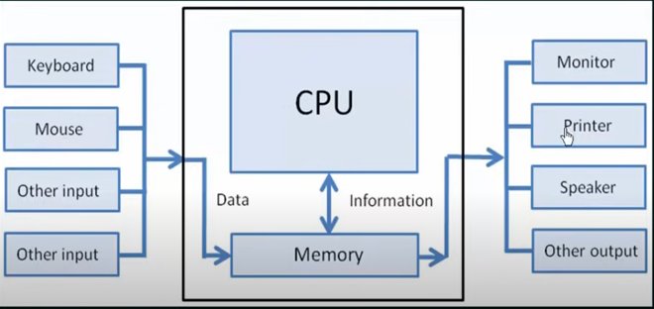
3. I/O operations
A running program may require input and output from a file or IO devices
For convenience and efficiency ,user can not directly interact with IO devices
OS provides a user interface between them so user can access the devices by read /write operations

Slide 26

4. File system Manipulation
In our system we are having multiple files and directories
OS system must control that how these files are manipulated or managed
Sometimes, We have create , edit, delete the file. Search for the file .
So all this is controlled by OS.
OS also controls the permission that given to certain prg or users so the file that we have cannot allowed to be used by every prg or user.

Slide 27
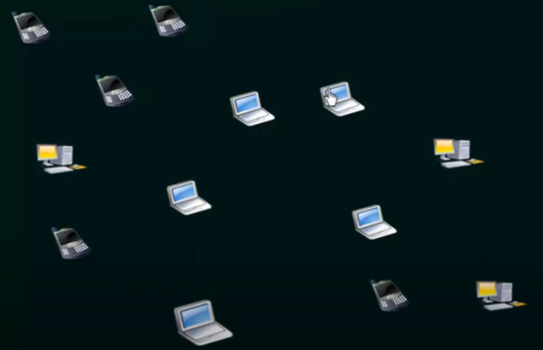
5. Communication
Program is in execution is known as a process
Processes may exchange information for synchronization , on the same computer or between computers over a network
Communications may be via shared memory (Tightly coupled system ) or through message passing (Loosely coupled system)
So this communication is controlled by OS

Slide 28
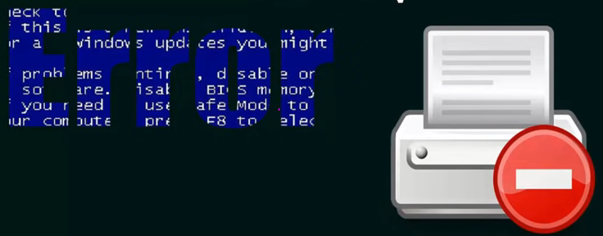
6. Error detection
OS needs to be constantly aware of possible errors
Error may occur in the CPU and memory hardware (memory error, power failure)
In I/O devices (connection failure in n/w) or in user program ,
for each type of error, OS should take the appropriate action to ensure correct and consistent computing.
When an error occurs your system should not break down completely or not seize your computing ability completely
OS must have a way so that your computing is consistent

Slide 29
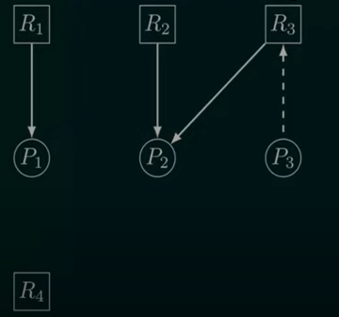
7. Resource allocation
Processes needed resources for execution
OS allocates the resources to the process in efficient way that all process should get the resource that they requested
we should not have a scenario where process is waiting for resource and it never gets it or deadlock etc

Slide 30

8. Accounting
If we want to keep track of which user uses which resource for how much time
Then OS helps in this
Why we need this track ?—for accounting –
Some times for billing purpose or accumulating usage statistics or for improving computing services by reconfiguring the system

Slide 31

9. Security & protection
Protection involves ensuring that all access to system resources is controlled
Security is from outside world for unauthorized access

Slide 32
System Call
System calls provide an interface between a process and the operating system.
It is a programmatic way in which a computer program requests a service from the kernel of the operating system.
System calls can typically be found as assembly language instructions or can be as routines written in c and c++.

Slide 33
Program is executing in 2 modes –User mode & kernel mode
User mode − Cannot access any hardware resources, which perform only the user operations.
Kernel mode − Can access hardware resources like RAM, Printer.
Due to security reasons, user applications are not given access to hardware resources, when they need any I/O or require some memory, it requests OS through system calls.

Slide 34
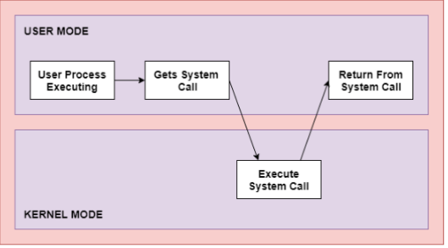
When prg switches from user mode to kernel mode is known as mode switching .
Or return to user mode is also mode switching

Slide 35
Why do you need system calls in Operating System?
The following situation require the use of system calls in OS:
System calls are necessary for reading and writing from files.
System calls are necessary for a file system to add or remove files.
New processes are created and managed using system calls.
System calls are required for packet sending and receiving over network connections.
A system call is required to access hardware devices like scanners and printers.

Slide 36
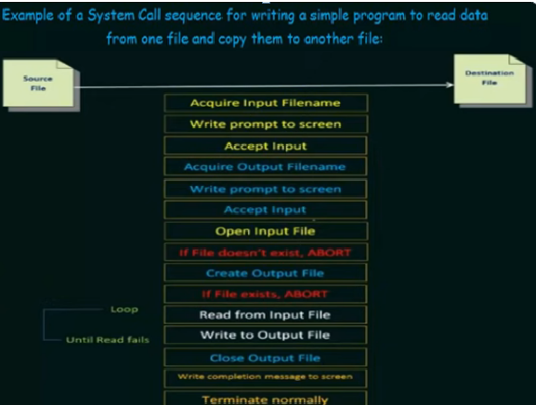
For a simple , task many system call are executing in a process

Slide 37
Types of System calls
Process Control
File Management
Device Management
Information Maintenance
Communication

Slide 38
Process control
This system calls perform the task of process creation, process termination, etc.
Functions:
End and Abort
Load and Execute
Create Process and Terminate Process
Wait and Signal Event
Allocate and free memory

Slide 39
2. File Management
File management system calls handle file manipulation jobs like creating a file, reading, and writing, etc.
Functions:
Create a file
Delete file
Open and close file
Read, write, and reposition
Get and set file attributes

Slide 40
3. Device Management
Device management does the job of device manipulation like reading from device buffers, writing into device buffers, etc.
Functions:
Request and release device
Logically attach/ detach devices
Get and Set device attributes

Slide 41
4. Information Maintenance
It handles information and its transfer between the OS and the user program.
Functions:
Get or set time and date
Get process and device attributes

Slide 42
5. Communication
These types of system calls are specially used for inter process communications.
Functions:
Create, delete communications connections
Send, receive message
Help OS to transfer status information
Attach or detach remote devices

Slide 43
System Calls | Windows | Linux
Process Control | CreateProcess() ExitProcess() WaitForSingleObject() | fork() exit() wait() exce() | fork(): Creates a new process. exec(): Executes a new program within a process. exit(): Terminates a process. wait(): Waits for a process to finish execution.
File Management | CreateFile() ReadFile() WriteFile() CloseHandle() | open() read() write() close() | open(): Opens a file. read(): Reads data from a file. write(): Writes data to a file. close(): Closes a file. unlink(): Deletes a file.
Device Management | SetConsoleMode() ReadConsole() WriteConsole() | ioctl() read() write() | ioctl(): Controls a device. read(): Reads data from a device. write(): Writes data to a device.

Slide 44
System Calls | Windows | Linux
Information Maintenance | GetCurrentProcessID() SetTimer() Sleep() | getpid() alarm() sleep() | getpid(): Gets the process ID. alarm(): Sets an alarm clock for signal. sleep(): Suspends execution for an interval.
Communication | CreatePipe() CreateFileMapping() MapViewOfFile() | pipe() shmget() mmap() | pipe(): Creates a unidirectional data channel. shmget(): Allocates a shared memory segment. mmap(): Maps files or devices into memory. socket(): Creates an endpoint for communication.

Slide 45
wait(): There are scenarios where the current process needs to wait for another process to complete the task. So to wait in this scenario, wait() system call is used.
fork(): Processes generate clones of themselves using the fork() system call. Clone is call child process.
exec(): This system call is called when the running process wants to execute another executable file. The process id remains the same while the other resources used by the process are replaced by the newly created process.

Slide 46
kill(): Sometimes while working, we require to terminate a certain process. So kill system call is called which sends the termination signal to the process.
exit(): When we are actually required to terminate the program, an exit system call is used. The resources that are occupied by the process are released after invoking the exit system call.

Slide 47
Types of OS
Batch Operating System
Multiprogramming Operating System
Multitasking/ Time-Sharing Operating System
Network Operating System
Real-Time Operating System
Distributed Operating System

Slide 48
Batch Operating System
Batch processing was quite popular in the 1970s.
Similar types of jobs have been batched together
Users submit jobs to an operator, who batches them together and runs them on the computer.
This type of system does not allow for interaction between the user and the job while it is being processed.
The system places all of the jobs in a queue, first come, first served, and then executes them one at a time.
When all of the jobs are completed, the users receive their respective outputs.

Slide 49
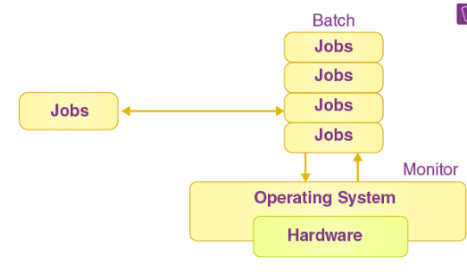
Advantages:
Efficient for large jobs that need little user interaction.
Maximizes the use of system resources by running jobs in batches.
Disadvantages:
Lack of interaction with the user. Users were not present at the time of execution
Debugging is difficult because errors are detected after the job is processed.
Example: Early IBM mainframes such as the IBM 1401
Batch OS

Slide 50
2. Multiprogramming Operating System
Multiprogramming is an extension to batch processing where the CPU is always kept busy.
Each process needs two types of system time: CPU time and IO time.
When a process completes its I/O in a multiprogramming environment, the CPU can begin the execution of other processes. As a result, multiprogramming helps in improving the system’s efficiency. It is non-preemptive.

Slide 51
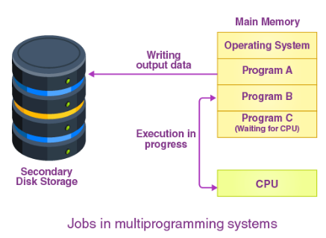
Advantages:
It increases the job throughput of the system since the CPU continually runs one program.
It is also possible to shorten response
Disadvantages:
they do not allow for any user interaction with the computer.
Example: Early versions of UNIX, IBM OS/360

Slide 52
4. Time-Sharing/Multitasking Operating Systems
This type of OS allows multiple users to share the system simultaneously.
Each user has a terminal connected to the main computer, and the OS allocates time slots to each user.
This creates the illusion of concurrent execution.

Slide 53
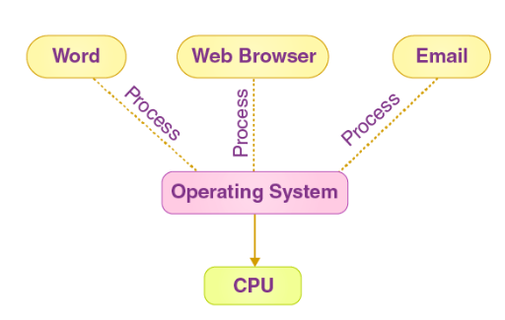
4. Multitasking Operating System
Advantages:
Efficient use of the CPU.
Users can interact with their programs while they are running.
Disadvantages:
Complexity in managing multiple users and processes.
Security and data integrity can be concerns.
Example: UNIX, Windows NT.

Slide 54
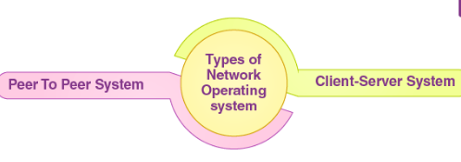
5. Network Operating System
Designed to provide networking features such as file sharing, printer access, and common administrative control over a local area network (LAN) or other network.
Each machine runs its own OS but communicates with others over the network.

Slide 55
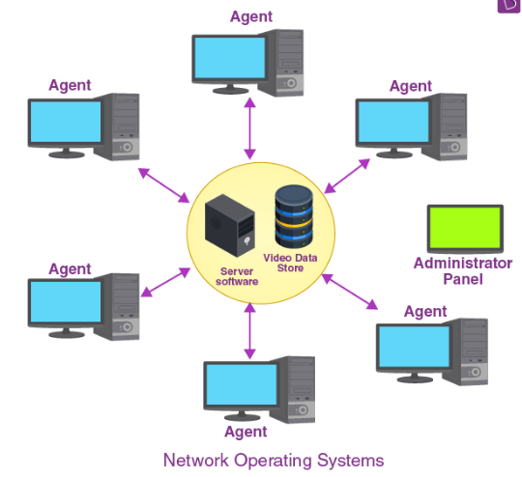
5. Network Operating System
Advantages:
Centralized management and security.
Easy resource sharing.
Disadvantages:
Dependency on network performance and reliability.
Management overhead.
Example: Novell NetWare, Windows Server.

Slide 56
6. Real-Time Operating System
RTOS is designed to process data as it comes in, typically within a strict time constraint.
Used in environments where timing is critical, such as embedded systems, medical devices, and industrial control systems.

Slide 57
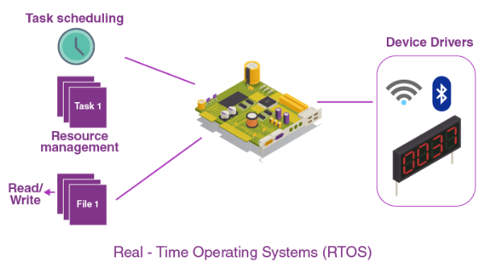
6. Real-Time Operating System
Advantages:
Predictable and consistent response times.
High reliability and performance.
Disadvantages:
Limited resource management.
Complexity in designing real-time applications.
Example: VxWorks, RTLinux.

Slide 58
7. Distributed Operating System
The Distributed Operating system is not installed on a single machine, it is divided into parts, and these parts are loaded on different machines.
A part of the distributed Operating system is installed on each machine to make their communication possible

Slide 59
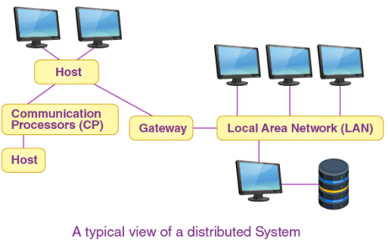
7. Distributed Operating System
Advantages:
High reliability and availability.
Scalability.
Resource sharing.
Disadvantages:
Complex to design and manage.
Network dependencies can introduce latency.
Example: Apache Hadoop, Windows Server.

